Slide 1
To-Do App keep it
Capstone Project –NIIT WAVE-42

Slide 2



To-Do App Team
Yashwant Mhamane
Vivek Pandey
Anupam Koolwal

Slide 3

Introduction
A To-do tracker is a tool that helps you keep track of your tasks and to-do lists.
To-do trackers typically allow you to create and organize tasks, set deadlines, and prioritize items.
To-do tracker can be a very useful tool for staying organized and productive, whether you're managing personal tasks or work projects.

Slide 4
To-Do List Features
Home page having functions like Add task, Search
& Filter Task and can view all tasks
Home
Can view only incomplete task also due dates can be appeared.
Inprocess
Completed Task are only visible can be marked as archived in this component
Completed
Archieved completed task can be viewed here and can unarchived .
Archieved
After edit task, changing completion or archieve status updated time will be reflected.
Notification

Slide 5
To-Do List Functanalities
Add Task
Edit task
Delete
Archieve
We can add multiple task with images or without images.
We can edit task details as we want after adding.
We can delete task one by one also we can delete all task in one click.
We can archieve and unarchieve completed task.
📝
📥
🚮

Slide 6
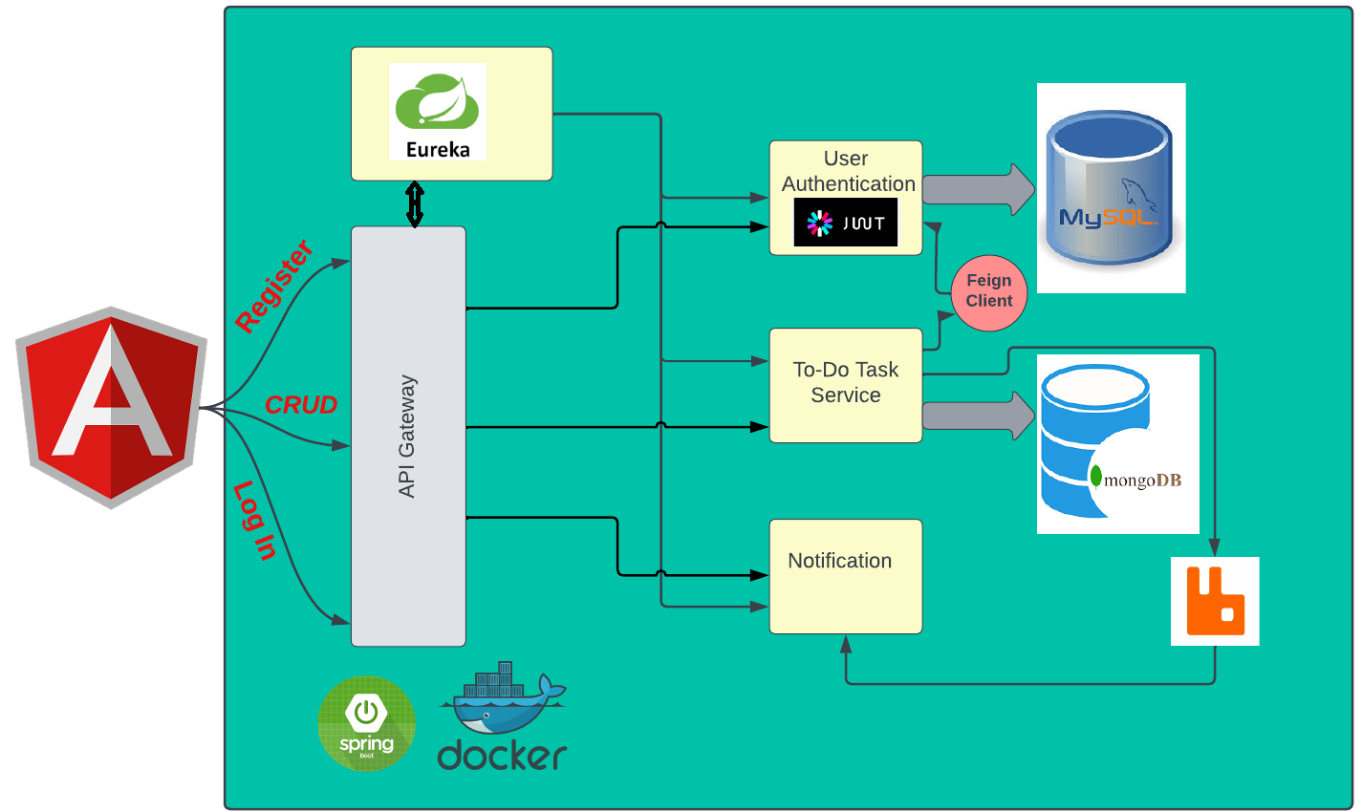
To-Do App Architecture Backend

Slide 7











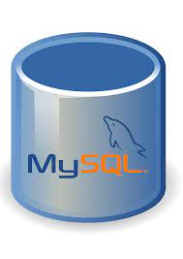



Technologies
HTML
Spring Boot
JWT Token
CSS
Docker
Feign Client
Type Script
Eureka Server
Api Gateway
Angular
Microservices
My SQL
Angular Material
Rabbit MQ
Mongo DB

Slide 8
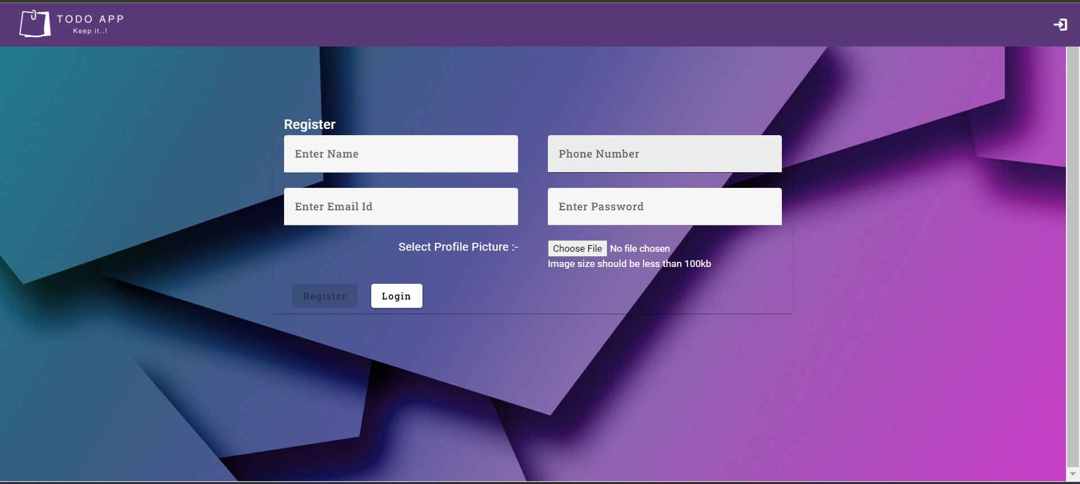
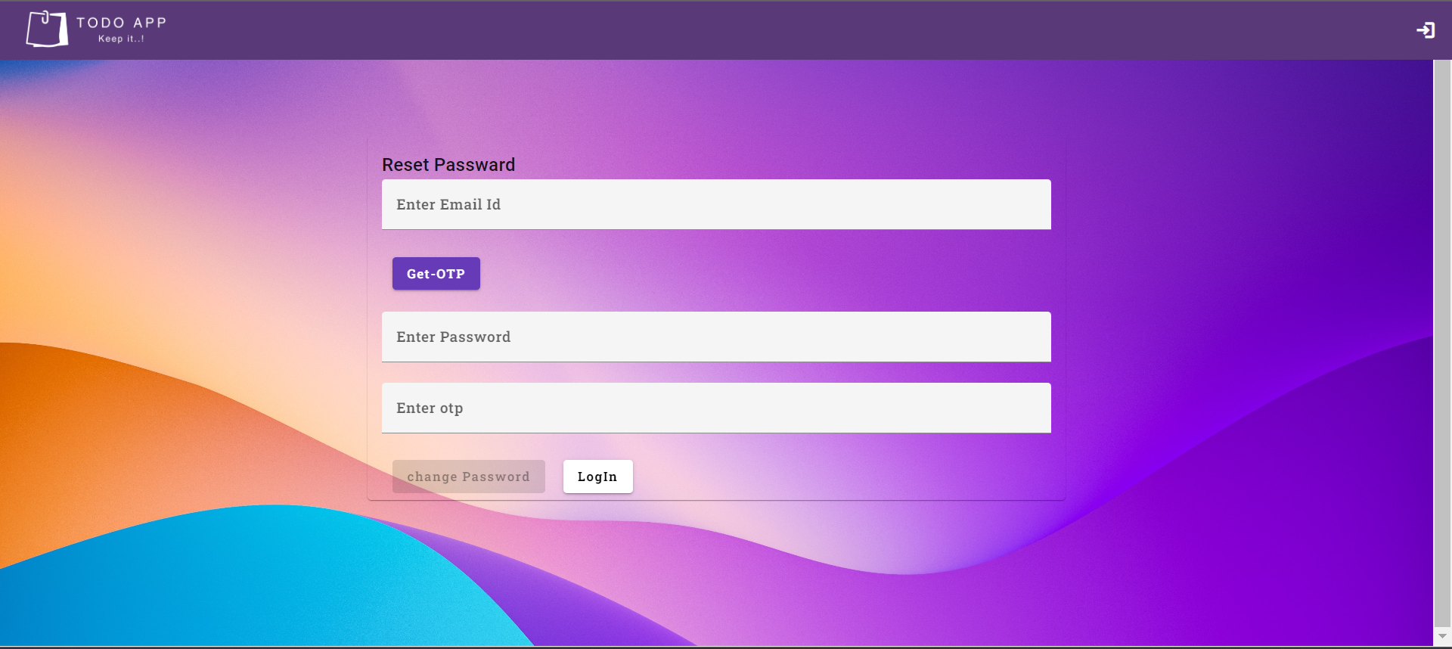
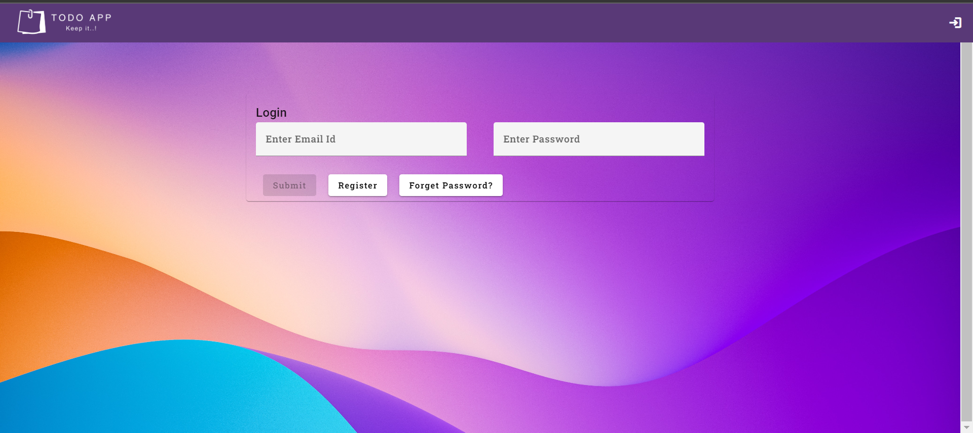
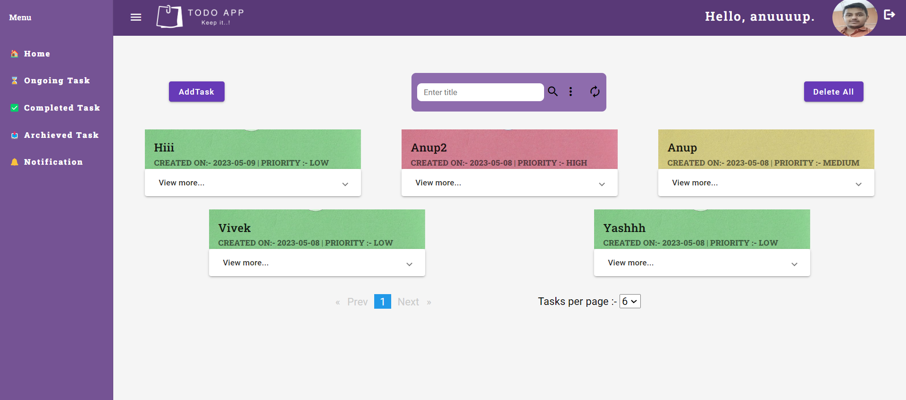
To-Do App Interactive Demo

Slide 9



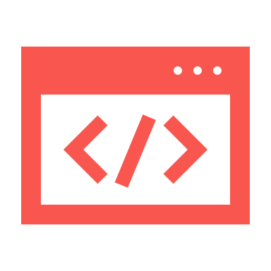
To-Do List Future Enhancement
To add notification on to-do list registration, completion of task and reminder mail to be sent.
Comments
Notification
Aiming to add subscription model for users so that users can have more benefit.
To Provide Better User Interface in future and enhance user Experience in more possible way.
Aiming to add comment facilities so that if any team is working on particular task they can communicate on comment section .
User
User Interface

Slide 10
Any Questions??

Slide 11


